Slide 1
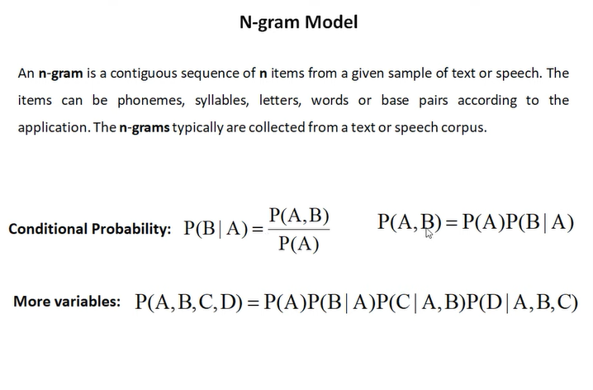
Simple N-gram models
An n-gram is a sequence of n words:
2-gram(bigram): is a two-word sequence of words like “please turn”, “turn your”, or ”your homework”
3-gram (trigram) is a three-word sequence of words like “please turn your”, or “turn your homework”.
probabilistic model that can estimate the probability of a word given the n-1 previous words, and thereby also to assign probabilities to entire sequences.

Slide 2
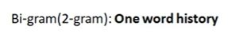
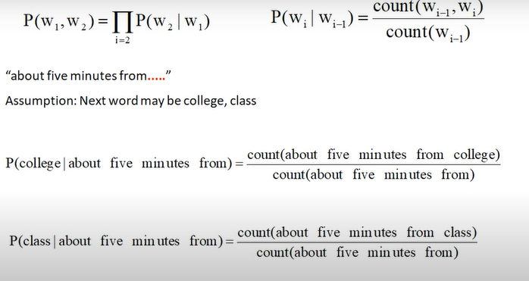

Slide 3
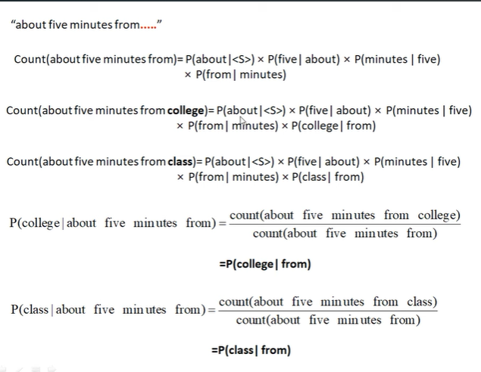
Other terms in numerator and denominator cancel out bcuz they are equal
Other terms in numerator and denominator cancel out bcuz they are equal

Slide 4
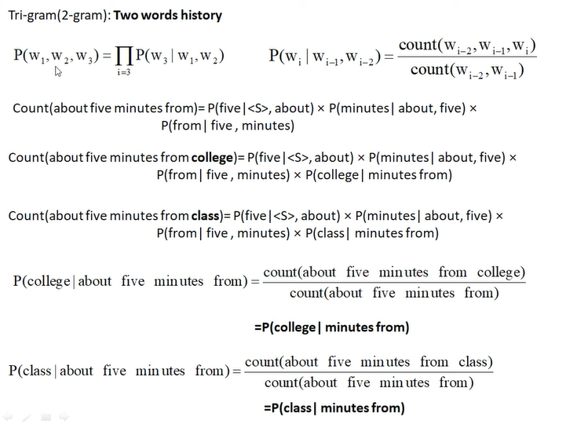

Slide 5
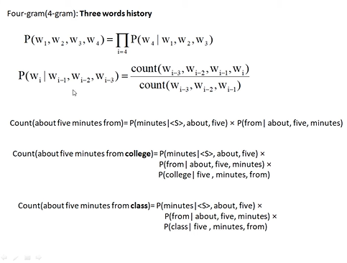

Slide 6
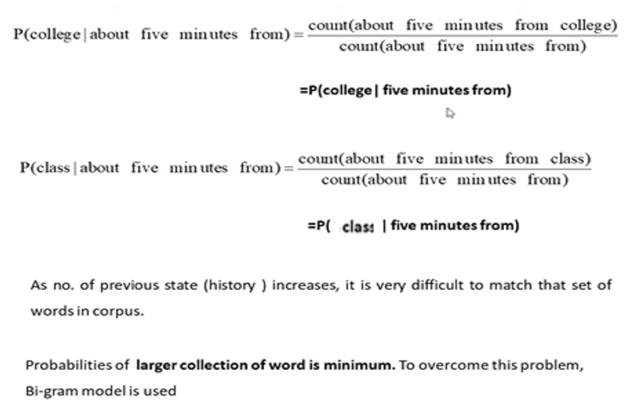

Slide 7
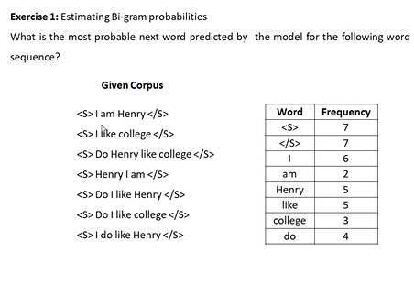
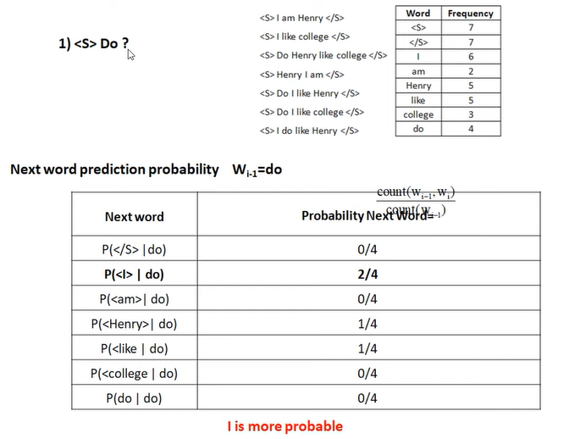

Slide 8
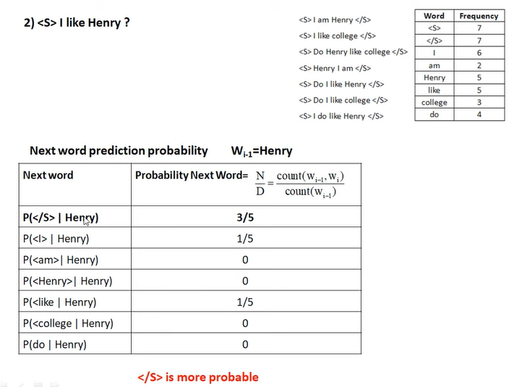

Slide 9
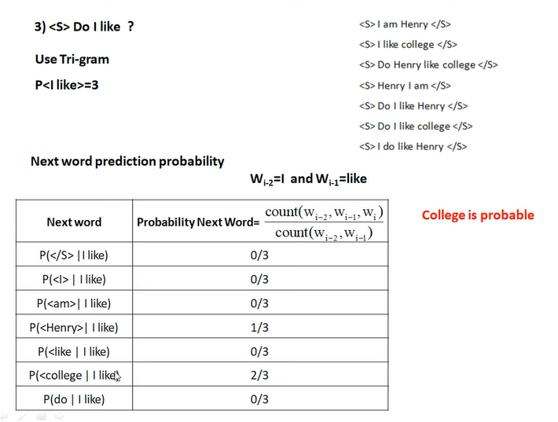

Slide 10
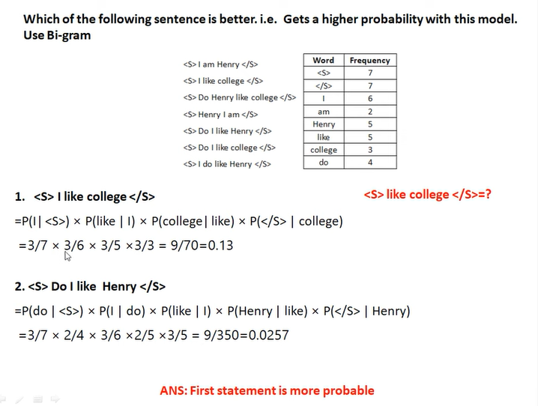


Whenever we multiply, underflow problem occurs. We can overcome this problem by adding log of all probabilities.
=log(3/7)+log(3/6)+log(3/5)+log(3/3) = -2.0513
=log(3/7)+log(2/4)+log(3/6)+log(2/5)+log(3/5) = -3.6607

Slide 11
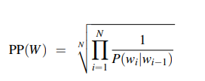
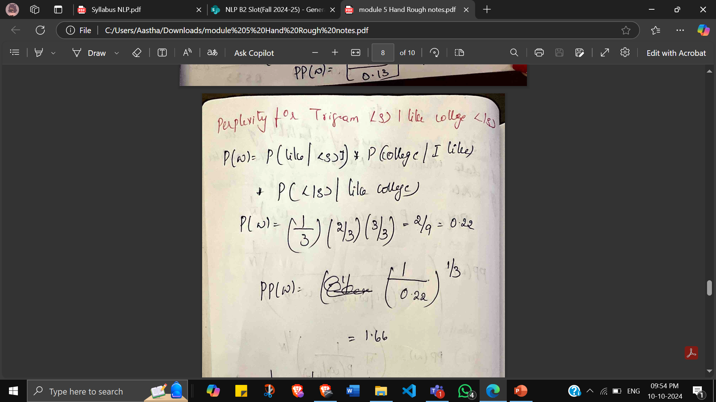
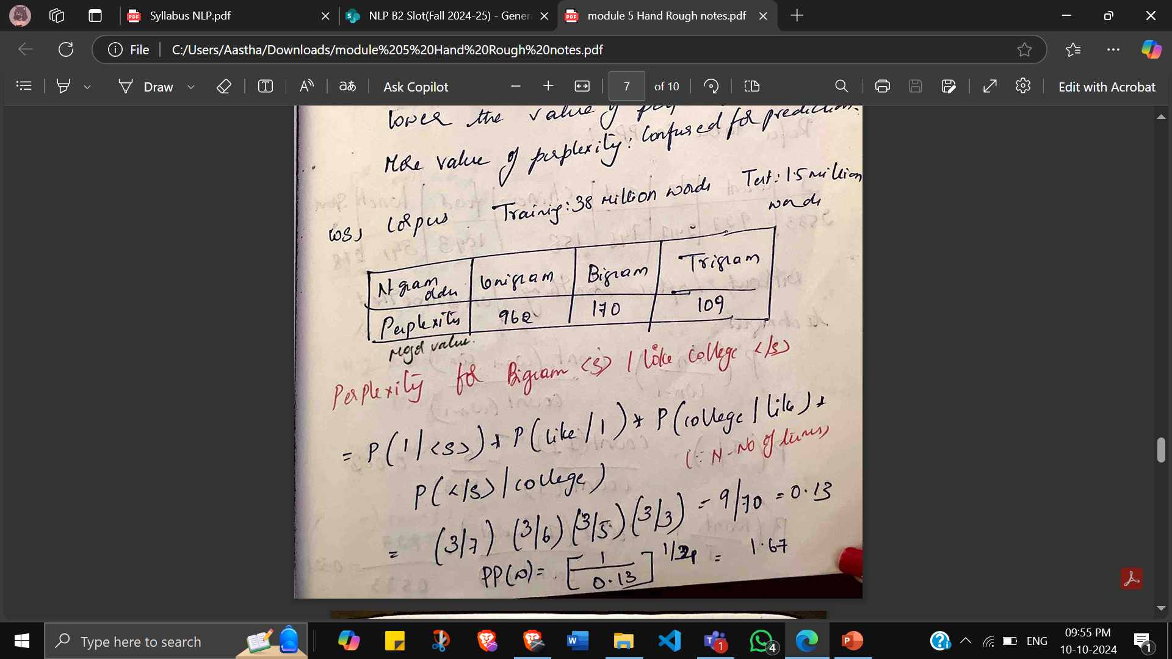
ESTIMATING PARAMETERS AND EVALUATING LANGUDAGE MODELS
Perplexity: the inverse probability of the test set, normalized by the number of words.
Lower perplexity -> better model, higher perplexity -> more confused for prediction

Slide 12
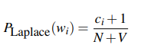
LAPLACE SMOOTHING
What do we do with words that are in our vocabulary (they are not unknown words) but appear in a test set in an unseen context (for example they appear after a word they never appeared after in training)?
Smoothing is the process of flattening a probability distribution implied by a language model so that all reasonable word sequences can occur with some probability. This often involves broadening the distribution by redistributing weight from high probability regions to zero probability regions.
The simplest way to do smoothing is to add one to all the bigram counts, before we normalize them into probabilities. All the counts that used to be zero will now have a count of 1, the counts of 1 will be 2, and so on.
V = (no. of unique words in corpus-1) and N = total no. of times w is occurring in corpus

Slide 13
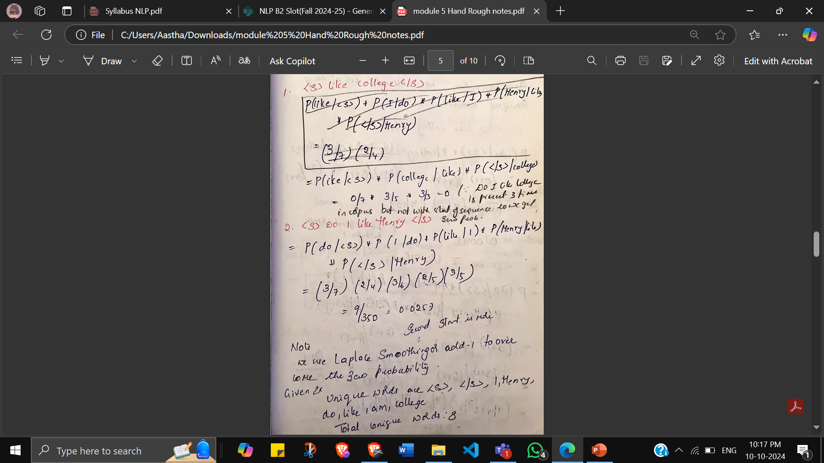
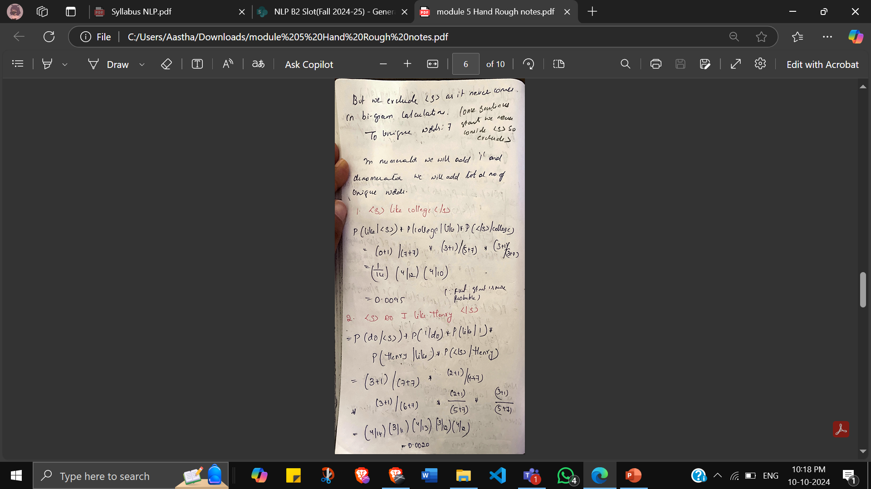

Slide 14
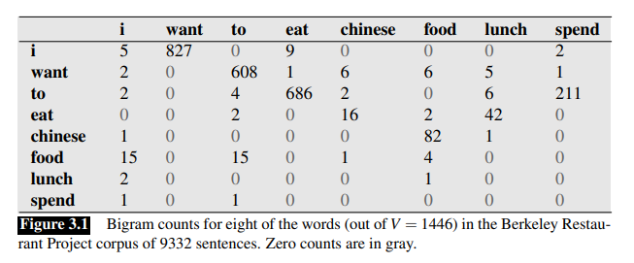
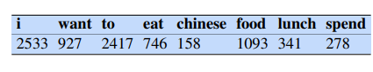
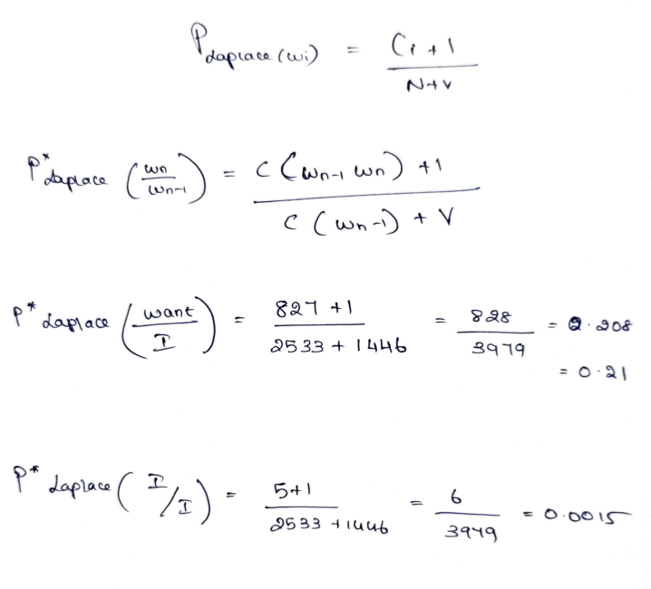
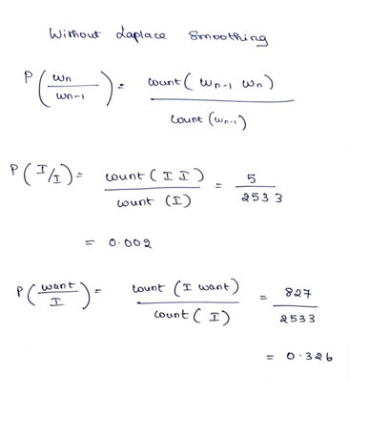
With Laplace smoothing

Slide 15
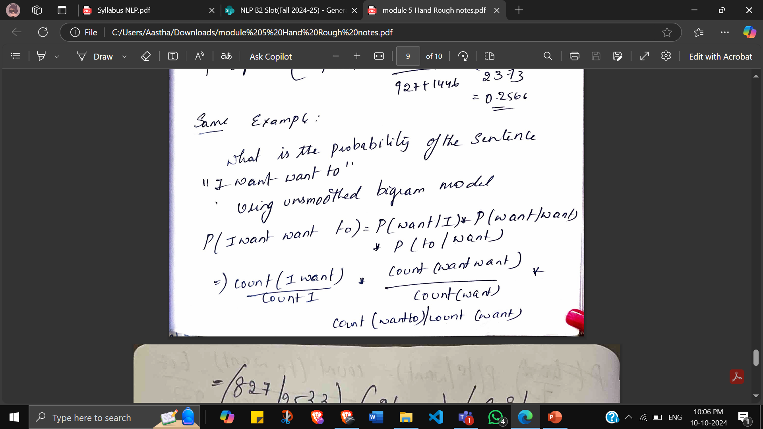
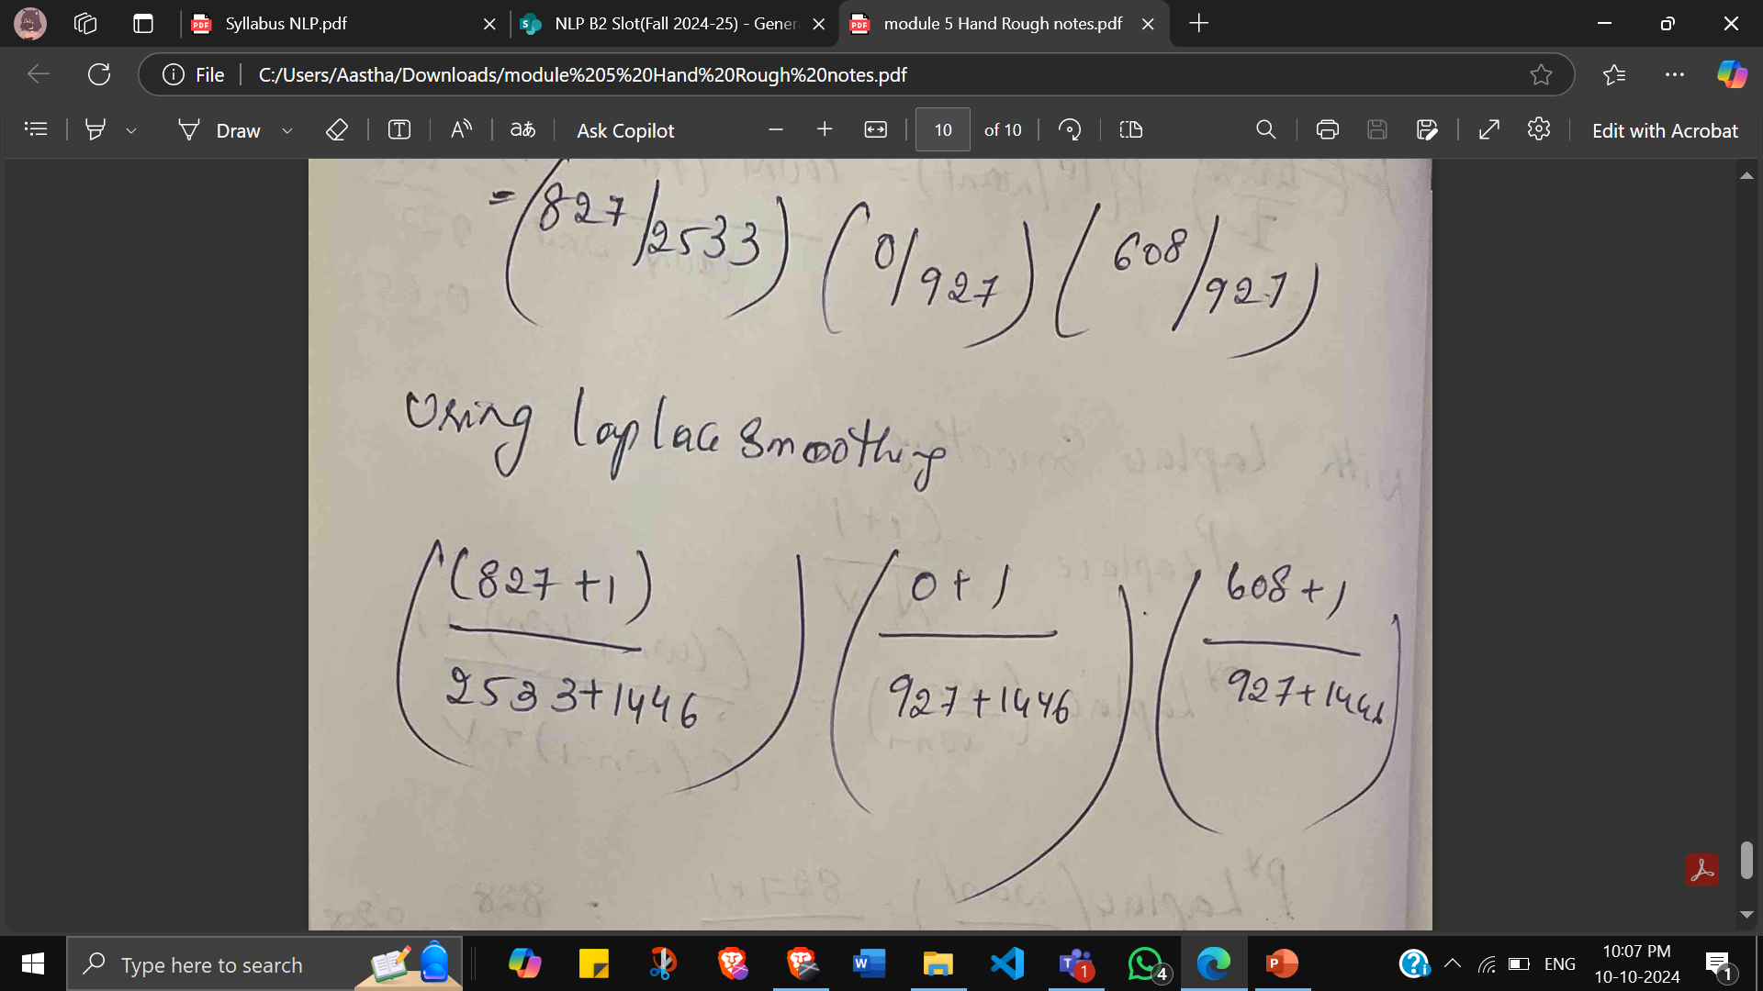
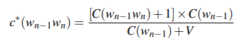
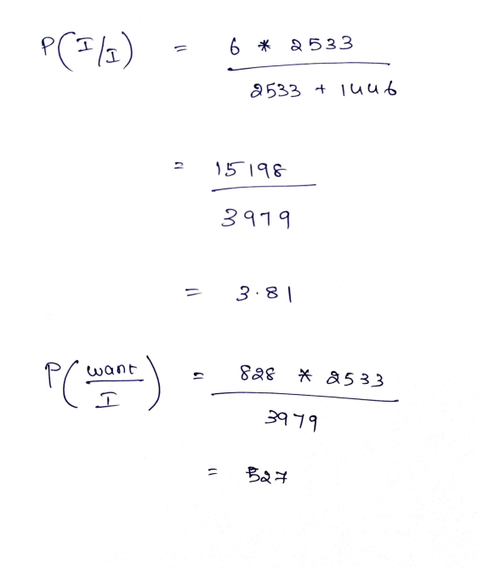
How much a smoothing algorithm has changed the original counts?

